Slide 1
Multicore Convex Hull Algorithms
Final Project Multicore Computing Matthew Molter and Joaquin Garrido

Slide 2
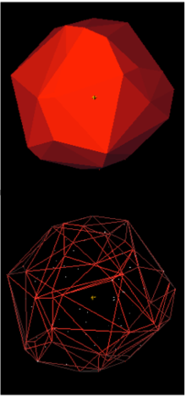
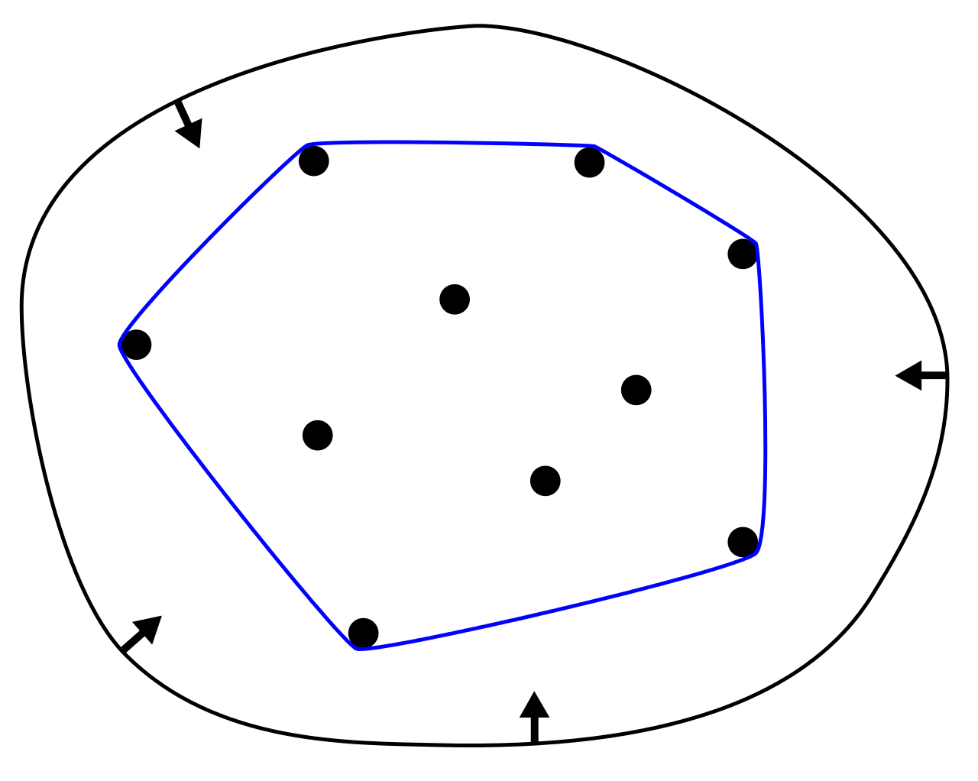
Convex hull of a shape is the smallest convex set that contains it.
Convex Envelope
Convex Closure
Not limited to 2D
* Images from Wikipedia

Slide 3
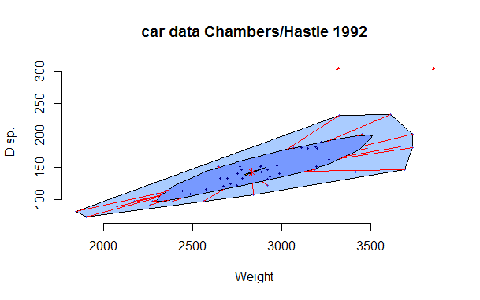
Some Applications of Convex Hull
Statistics & Math in General
Visualization (Bagplot)
Decision Theory
Combinatorial Optimization
Economics
Equilibrium Models
Quantum Physics
Schrödinger-SJW Theorem
Animal Behavior
* Image from Wikipedia

Slide 4
2 Main Strategies
Divide-and-Conquer
Split in subgroups
Merge hulls
Parallelization of Iterative sequential algorithms
Divide sequential, but independent tasks among threads
Merge segments

Slide 5
Quarter Hull, by Jigang Liu
Calculate angle for each point around center of points (360°)
Sort points by angle. Implemented Quick Sort, can be parallelized
Identify min, and max in x and y
Split set of points in 4 “quadrants” defined by extreme points
Test each edge to keep points in final hull
Liu, Jigang, "Parallel Algorithms for Constructing Convex Hulls." (1995). LSU Historical Dissertations and Theses. 6029

Slide 6
Notes in Quadrant Hull
We do not expect improvements with every extra thread used
We study the cases with the following number of threads:
1
2
4
8, needs extra merger step

Slide 7
Divide-and-Conquer
Initial split is vertical, into upper and lower hulls
Split is chosen by whether point is above or below the line created by connecting the two extreme horizontal points
Done in O(n) time
Notes:
Extreme points included in both upper/lower hulls, and redundancies eliminated during combination at the end
One of the more time consuming portions of the algorithm
Could be parallelized in order to save more time

Slide 8
Divide-and-Conquer
Once initial split completed, second split is done horizontally
Split evenly by size of set / number processors
The way this was implemented (in place) leads to O(1) time complexity
Notes:
Extreme points included in both upper/lower hulls, and redundancies eliminated during combination at the end
One of the more time consuming portions of the algorithm
Could be parallelized in order to save more time

Slide 9
Divide-and-Conquer
After split is done, hulls are found on each individual set
Beginning at left most point, push first two points onto stack
Compare top of stack to second item in stack, and item pending push to the stack
If top of stack is above both, then hull formed is convex and you push next item
If top of stack is below either, hull is concave, and is popped from the stack
Repeat until you reach the rightmost point
O(n) time complexity
Notes:
No overlap of points in this case

Slide 10
Divide-and-Conquer
After each individual hull has been found, algorithm combines them among upper/lower sets
Hulls are combined along common tangent line
Tangent line is found through modified binary search
Starting in middle of each side, line is determined to be tangent via the same method as convexity (above/below line connecting neighbor points)
Point moves by increasingly smaller steps in direction of common tangent
Done in O(logn) time
Notes:
Definition of convexity, line is convex

Slide 11
Divide-and-Conquer
Last step is to merge the upper/lower hulls
Done by copying lower hull elements to the upper hull
Done in O(n) time, but number of points in hull is presumably very small in proportion to those in set
Ex: ~500 point hull on 1,000,000 set
Notes:
Definition of convexity, line is convex

Slide 12
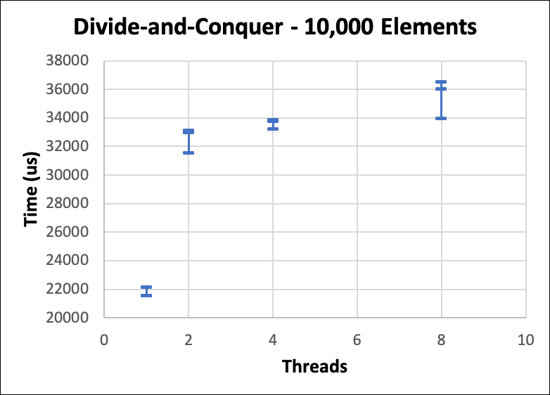
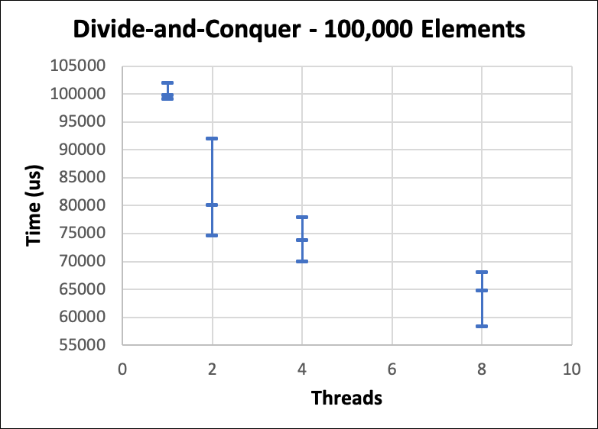
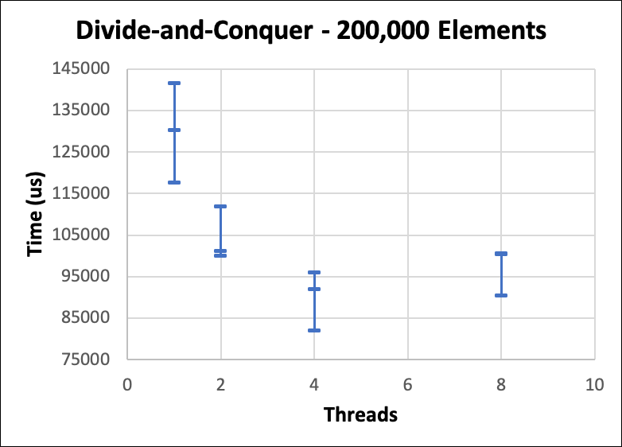
Results – Divide-and-Conquer Time vs Number of Threads

Slide 13
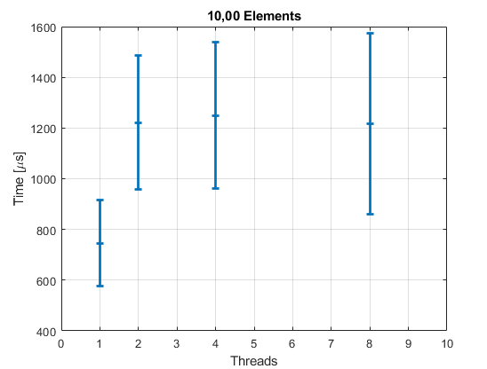
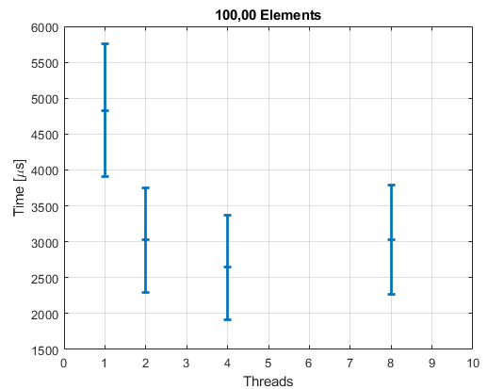
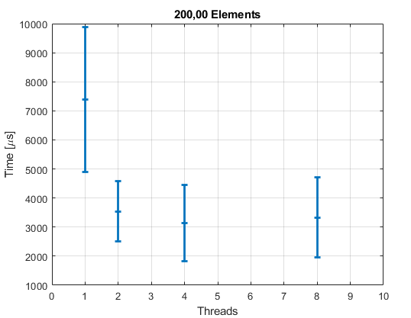
Results – Quarter Hull Time vs Number of Threads

Slide 14
Thank you! Questions?

